Slide 1
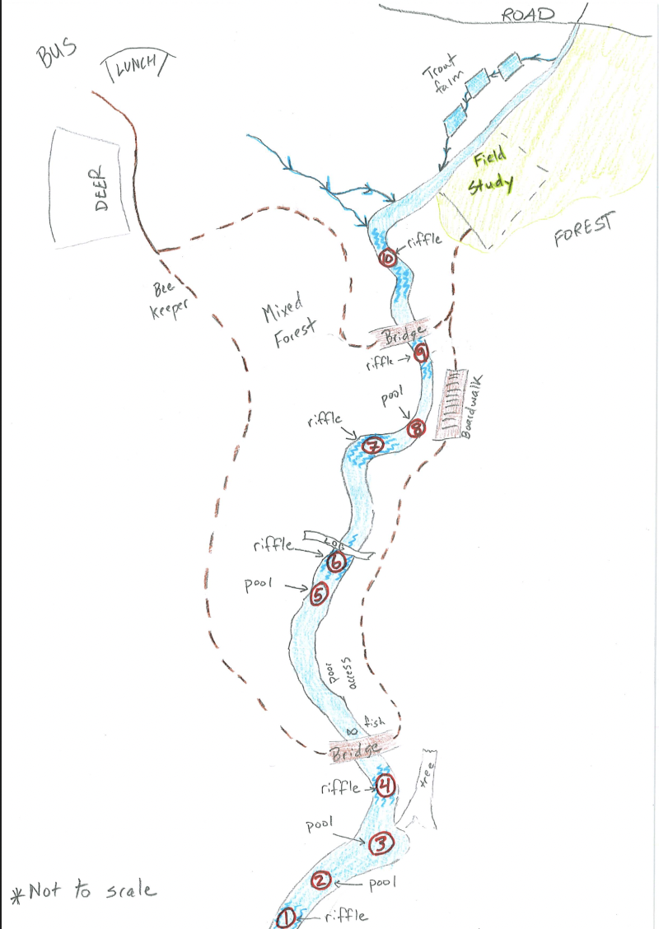
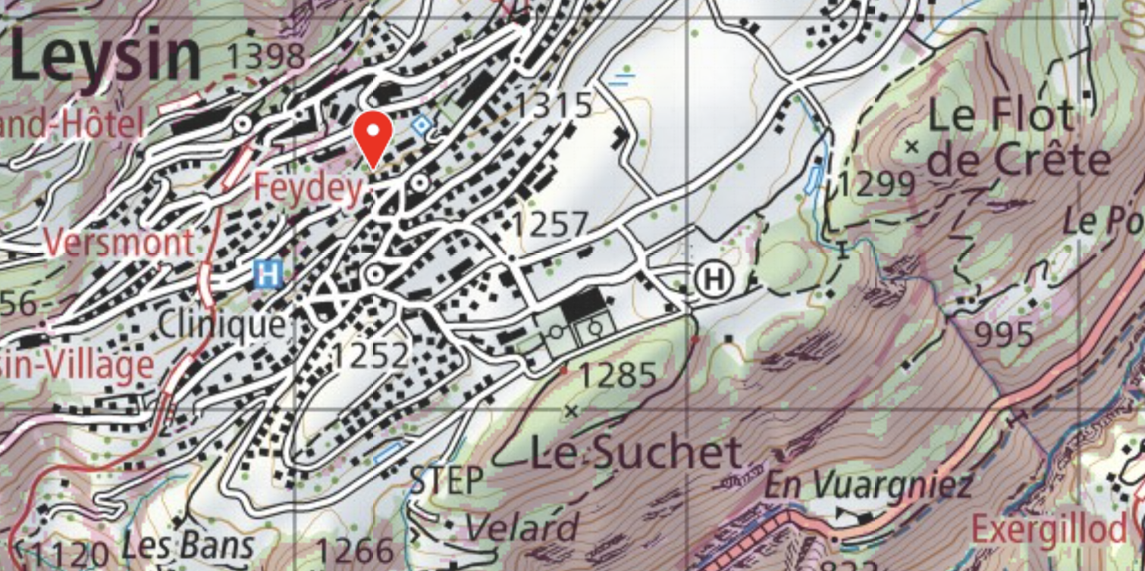

Ecosystems Handbook
Who are you?
Reflection
You will be asked to chose three images to reflect on your day. Keep a photographic record as you go along today
Why are you here?
Learning Objectives:
Knowledge:
1. Measure water quality using biological
indicators
2. Identify common species of freshwater
stream
3. Identify the relationships between different abiotic and biotic factors in freshwater streams
Skills:
1. Enhance scientific process skills: repeatability, reliability, standardising methods
2. Apply scientific language
3. Make accurate observations and measurements
Attitude:
1. Appreciate the high biodiversity in local stream ecosystem.
2. Recognise the effect of human activities on the stream ecosystem
3. Recognise the need and their responsibility to conserve local stream

Slide 2
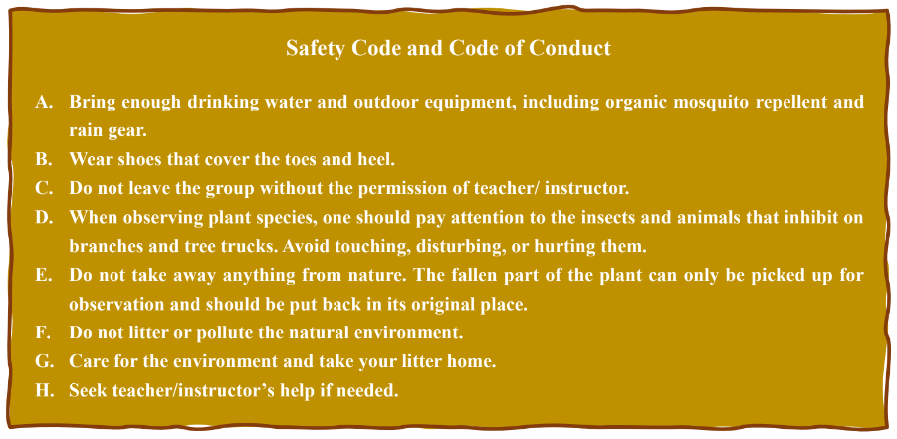
Task 1. Equipment checklist
Handbook, clipboard and pencil
A charged phone with teacher contacts and knowledge of numbers for emergency services?
Species identification guide Paper copy of ID chart iSeek App
Sample Bottle (250mL)
Net (Groups 1-4) These will be passed up the river as samples are taken below you
Sample Tray
Kick Quadrat
Wellies
Magnifying glasses
Water testing strips
Thermometer
Creamer
Ruler

Slide 4
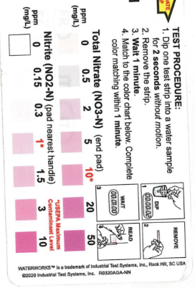
Physico-chemical Indicators (~15 mins)
What position on the stream are you? (1-10)
Type of water flow | *pool/riffle
 | 1 | 2 | 3 | mean
Velocity
Width of river
Depth of river
pH
Temperature
Nitrates
We need to REPEAT the method for reliability
We need to STANDARDISE the method for accuracy
And to make the data
comparable between sites
comparable between different years
Read how to do this below …
How to measure pH
pH - place the probe the middle of the water column
Check this with the litmus paper indicator
How to measure depth and width
Hold the meter ruler in the water at three location on your site vertically touching the stream bed. Measure where the water line is most of the time over 30 seconds
Measure three widths of the stream at the edge of the water where it meets the bank horizontally
Nitrates
Place stick in middle of water column for 2 seconds Do not move it about
Wait 1 minute check colour against chart
How to measure velocity
Place a meter ruler in the water
Hold a phone above the ruler and video
Release creamer and film the movement holding the phone still
Calculate the time taken for the creamer to move 1m - repeat as necessary
velocity = distance/time
How to measure temperature
Hold the thermometer in the middle of the water column
for 30s
Read the temperature whilst still in the water
If analogue - read at at eye level (get down to the thermometer)

Slide 5
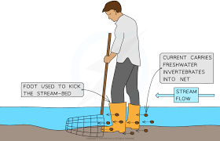
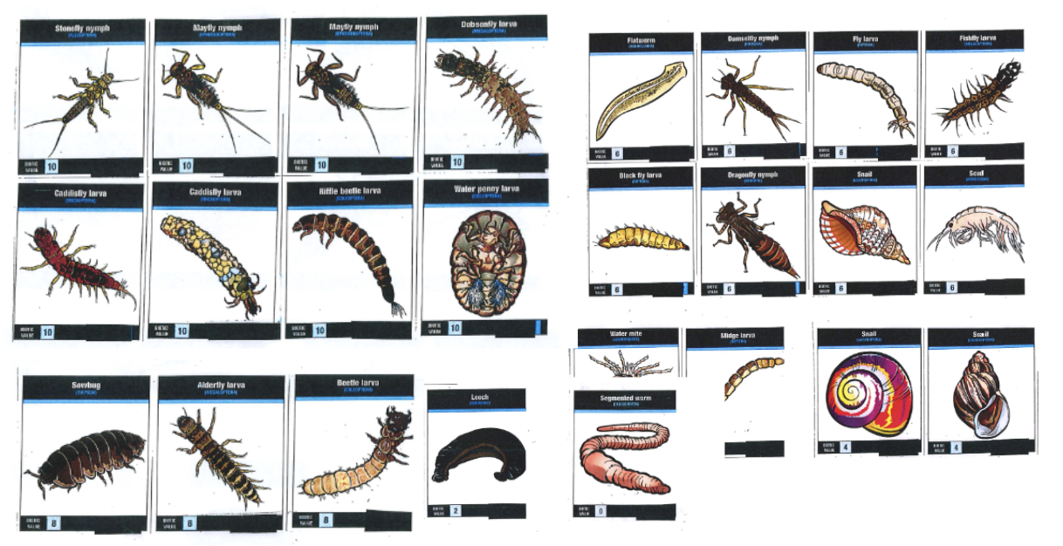
Exploring the Biotic Community in and around the Local Stream (1 hour) Identifying species at your stream site using a standardised method for the kick sample (30 minutes)
How to collect a Kick Sample
You need:
a net , a sorting tray, spoons and pooters, Wellies
Standardise your method
Choose a safe location
One person hold the net vertically making
sure the net is flat against the streambed
Wash large rocks with your hands into the net and build a barrier either side of the net with the rocks to chanel the water flow into the net
Place a quadrat in the stream
Scrape with your heel for 1 minute to dislodge invertebrates into the net
Use the pooters and spoons to sort the organisms in the sorting tray for 10 minutes
Take a picture
Count the organisms and record from the picture if it is easier
Species | Number (n) | Species | Number (n)
stonefly |  | Damsel fly
mayfly |  | Black fly
Uncased Caddis |  | shrimp
Cased caddis |  | snail
Siffle beetle |  | leech
Beetle larvae |  | Water penny
Flat worm |  | Segmented worm
From this you can calculate biotic index to measure water quality !!!

Slide 6
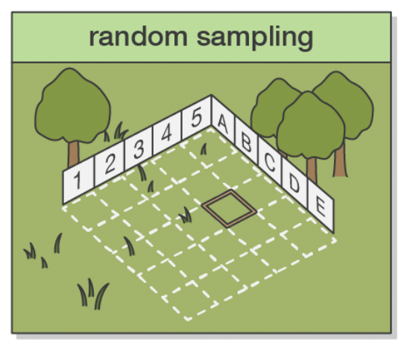
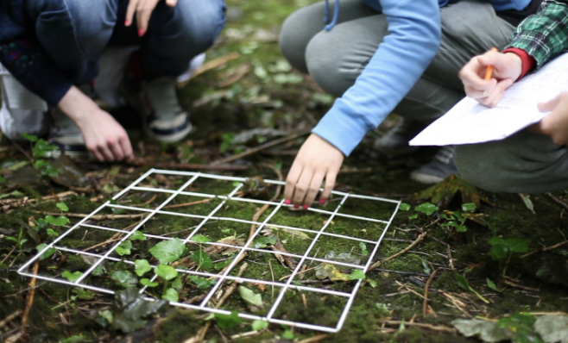
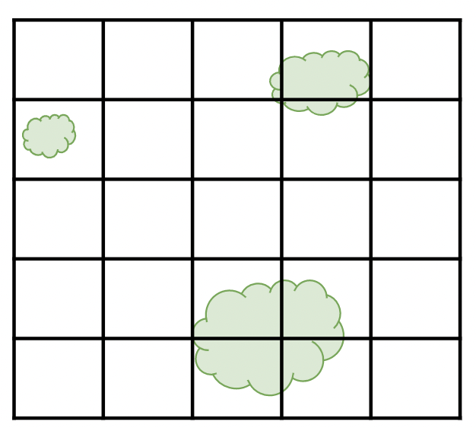

Meadow: Marsh V Drained agriculture
Comparing two sites for species diversity and species richness (30 minutes)
We will carry out random sampling of the plant life in two sites
Marsh ungrazed and Drained grazed
Step 1:
Agree on the species labels A, B, C, D etc on a card
Take a picture of the ID chart (you can identify species later using iseek
Lay out two 30m tape measures at right angles
Find a random coordinate using a random number generator
Place the bottom left corner of the quadrat at the coordinate
Each square represents 4%
If the species is present in the square count it as 4% if it is absent it gets 0%
Record % cover in the table for each species.
Species | % cover | Species | % cover
A |  | I
B |  | J
C |  | K
D |  | L
E |  | M
F |  | N
G |  | O
H |  | P
From this you can calculate: simpsons diversity index and presence absence of species against abiotic factors !!!

Slide 7
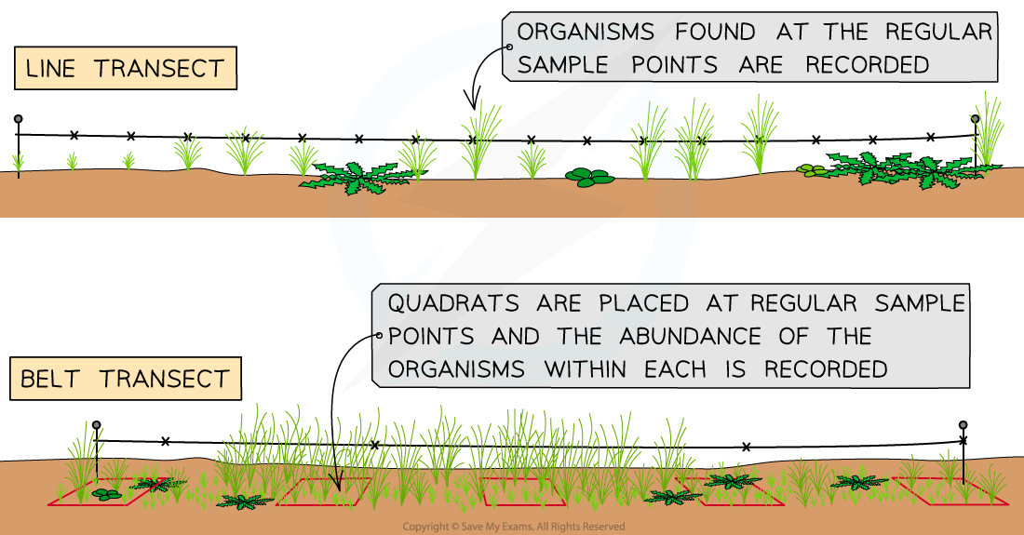
Extension: How does the distribution of species vary as you move away from the stream? Conducting a line transect biological survey
Here are two methods to collect this type of data. You will use the line transect method
Setup a 10 metre line from the edge of the river.
Prepare to identify and record all the species in 1 metre intervals within the quadrat in the same way as previously done
Use the iSeek App and start identifying.
0m | 1m | 2m | 3m | 4m | 5m
6m | 7m | 8m | 9m | 10m

Slide 8

Challenging Question
Local focus:
What is water quality like in this stream in
Switzerland?
Does this reflect the quality of water everywhere in Switzerland?
Global focus:
Does this reflect the water quality in your home country?
General questions:
What are the challenges that aquatic animals in stream face?
What are the adaptive features of these organisms to the challenges found in their environment?
Reflection
Provide three images
state why you used these images
Save in this folder
https://drive.google.com/drive/folders/15bb0EKqPG0fOwsSVINjZPeuDOkHhsuW_?usp=sharing

